Slide 1

Database
CCS5001
Database Design

Slide 2

Learning Objectives
01
Describe the database design stages
02
Explain the construction of ER Diagram

Slide 3
Database Design Stage
1.
Identify the exact goals of the system
4.
Design the tables and relationships
2.
Talk to the users to identify the basic forms and reports
5.
Identify any business constraints.
3.
6.
Identify the data items to be stored.
Verify the design matches the business rules

Slide 4
The Entity Relationship (ER) Model has become a widely accepted standard for data modeling and are normally represented in an Entity Relationship Diagram (ERD), which uses graphical representations to model database components. The three common ER notations are shown below: the original Chen notation, the Crow’s Foot notation, and the newer class diagram notation, which is part of the Unified Modeling Language (UML).

Slide 5
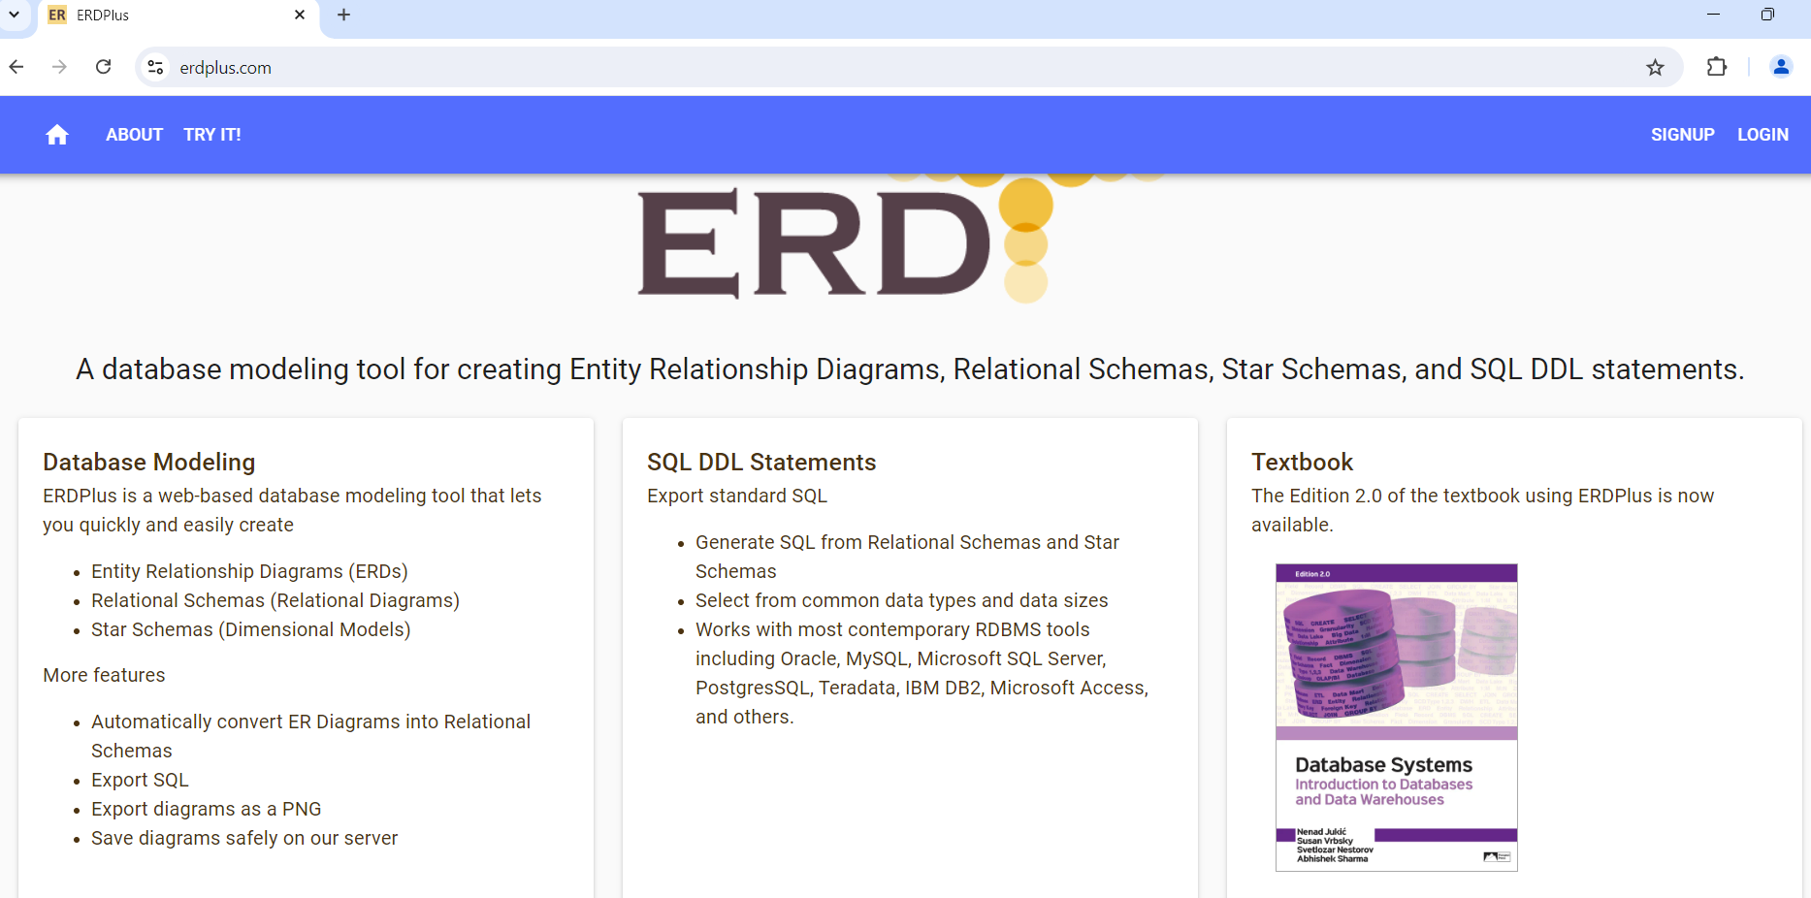
In this course, we use ERDPlus which combines the Chen and Crow Foot notations

Slide 6
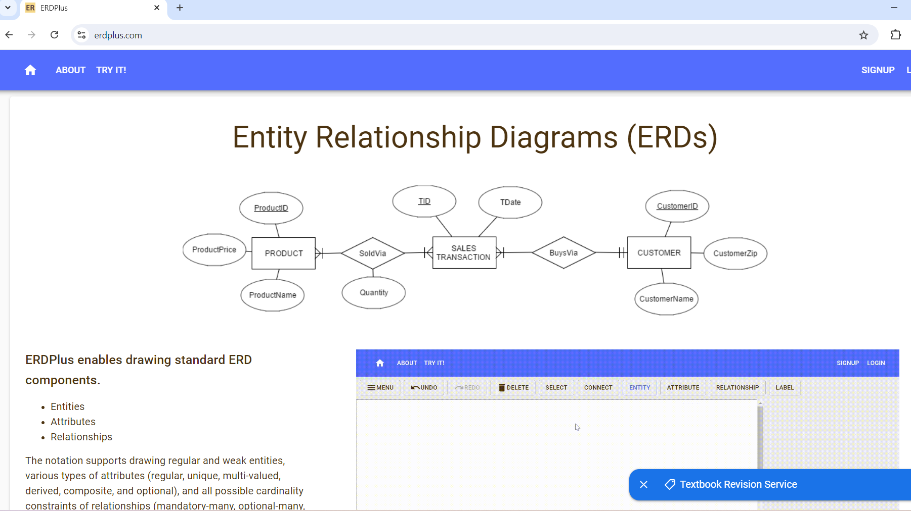
ERDPlus combines the Chen’s entity, relationship and attributes notations with the Crow’s Foot cardinality notations.

Slide 7




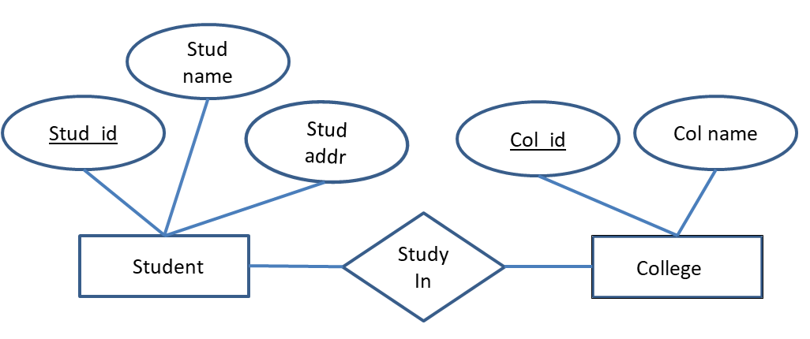
ER Model
ER model – a logical representation of the data for an organization or a business area
ER diagram – a graphical representation of an entity-relationship model
ER Diagram

Slide 8
ER Model Constructs
Rena
UPM
UPM
Ali
RELATIONSHIP
STUDENT
Rena
Ali
RELATIONSHIP
ATTRIBUTE
association between the instances of one or more entity types, i.e., link between entities
Example: Rena study in UPM, Ali study in UPM
COLLEGE
ENTITY
ATTRIBUTE
property or characteristic of an entity type.
Example: Name of Student Entity, Name of College Entity
ENTITY
person, place, object, event, or concept in the user environment about which data is to be maintained.
Example: Student, College

Slide 9
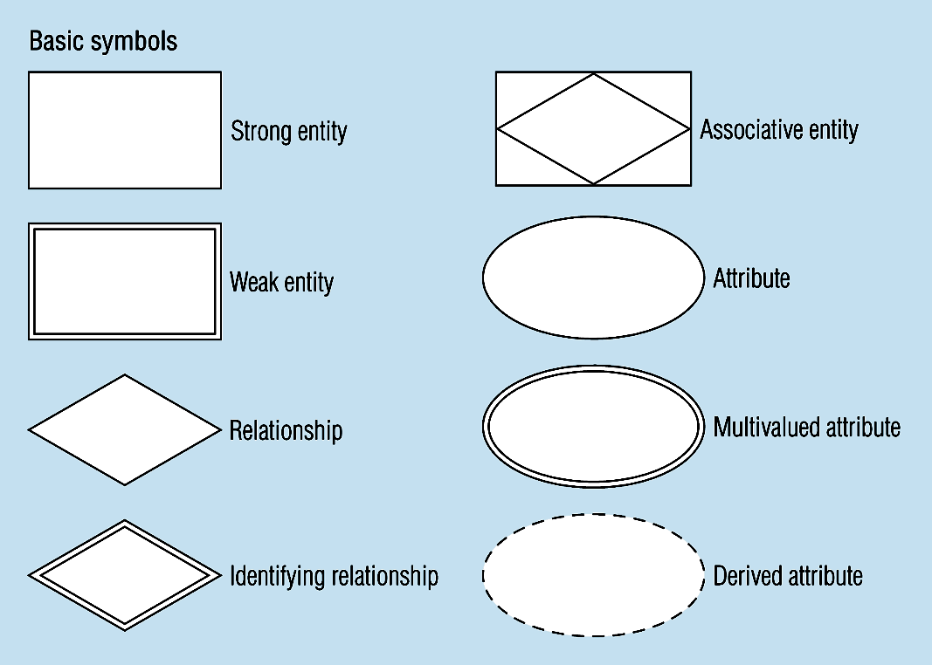
Basic ER Notation
A special entity that is also a relationship
Entity symbols
Attribute symbols
Relationship symbols

Slide 10




Entity
Entity type represents a set or collection of objects in the real world that share the same properties.
Entity Identity | Example of Entity Type
Person | STAFF, STUDENT, LECTURER
Place | DISTRICT, TOWN, STATE
Object | BUILDING, TOOL, PRODUCT
Event | REGISTRATION, APPLICATION
Concept | COURSE, ACCOUNT
Example of Entity types according to its identity

Slide 11
Entity
Entity Type vs. Entity Instance
Entity Type - a collection of a similar type of entities (often corresponds to a table)
Entity instance - a single occurrence of an entity type (often corresponds to a row in a table)
Strong vs. Weak Entity Types
Strong Entity Type – an entity that exists independently of other entity types
Weak Entity Type – an entity type whose existence depends on some other entity type

Slide 12

Example of Entity Type vs. Entity Instances
Entity Type: STUDENT
NAME | ADDRESS
Avinesh | Damansara
Sandra | Petaling Jaya
Alisya | Ampang
Rena | Cheras
Amirul | Serdang
Each row represented an entity instance of the entity type. Hence, each student is an entity instance for the STUDENT entity.
Avinesh
Damansara
Sandra
Petaling Jaya
Alisya
Ampang
Rena
Cheras
Amirul
Serdang

Slide 13
Strong vs. Weak Entities, and Identifying Relationships
Strong entities
exist independently of other types of entities
has its own unique identifier
represented with a single-line rectangle
Weak entity
dependent on a strong entity…cannot exist on its own
Does not have a unique identifier
represented with a double-line rectangle
Identifying relationship
links strong entities to weak entities
represented with double line diamond
CUSTOMER
DELIVERY_ADDR
has

Slide 14
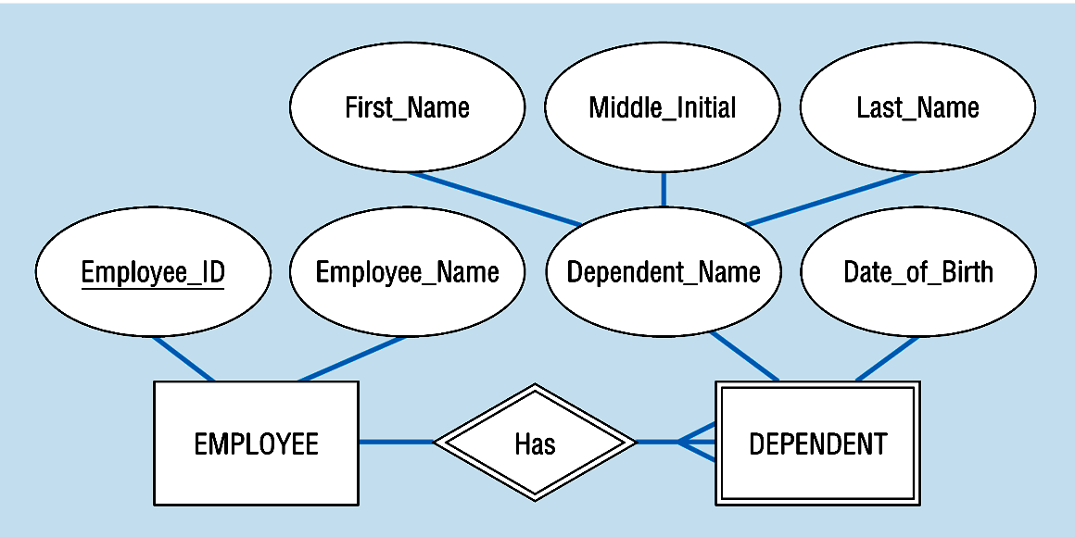


Strong and weak entities, Identifying relationship
Strong entity
Identifying relationship
Weak entity

Slide 15
Naming and Defining Entity
Use singular nouns.
It should be descriptive and specific.
For example, PURCHASE_ORDER and CUSTOMER_ORDER cannot be named ORDER1 and ORDER2.
It should be concise.
For example, REGISTRATION_FOR_STUDENT_IN_CLASS
The event’s entity type should be named for the event’s result, not the event’s activity or process.
For example, a project manager assigning an employee to work on a project should be named ASSIGNMENT.

Slide 16
Attribute
Simple vs. Composite Attribute
Simple attribute – cannot be broken into smaller components
Composite attribute – can break into smaller components
Single-Valued vs. Multivalued Attribute
Single-Valued – each of the attributes has one value
Multivalued – attribute more than one value
Stored vs. Derived Attributes
Stored attribute – data input or set
Derived Attribute – attribute whose values can be calculated from related attribute values.
Identifier Attributes

Slide 17
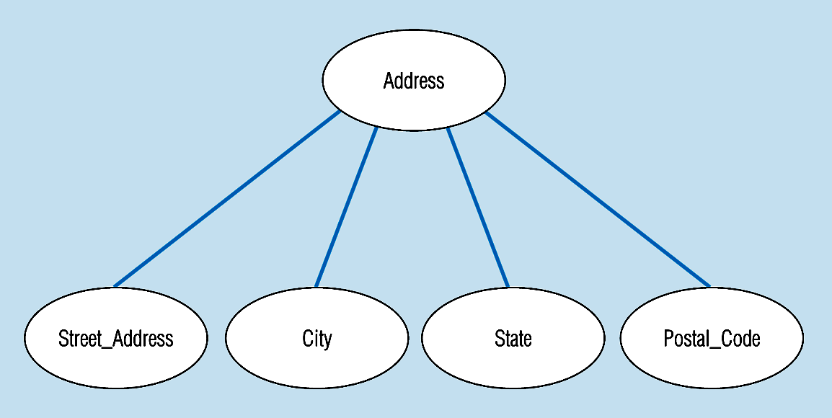
An Example of Composite Attribute
An attribute can be broken into smaller components

Slide 18
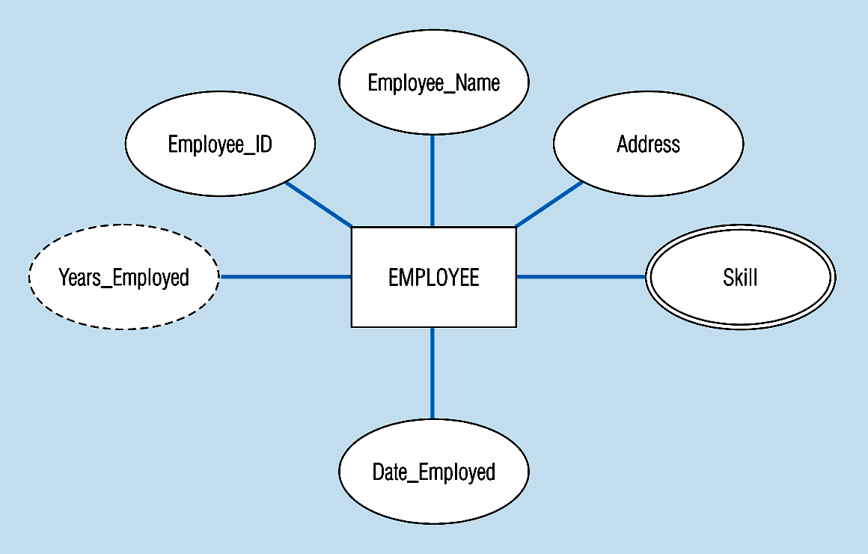
An entity with a multivalued attribute (Skill) and derived attribute (Years_Employed)
Multivalued:
an employee can have
more than one skill
Derived
from date employed and current date

Slide 19
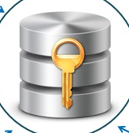
Identifier (Key)
Identifier (Primary Key) - An attribute (or combination of attributes) that uniquely identifies individual instances of an entity type
Composite Identifier – an identifier that consists of a composite attribute.
Candidate Key – an attribute that could be a key…satisfies the requirements for being a key

Slide 20
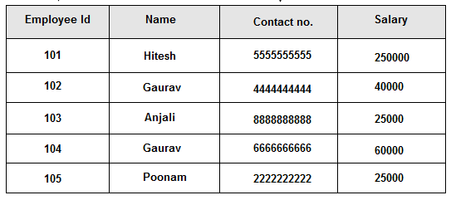

Simple Identifier: Employee Id

Slide 21
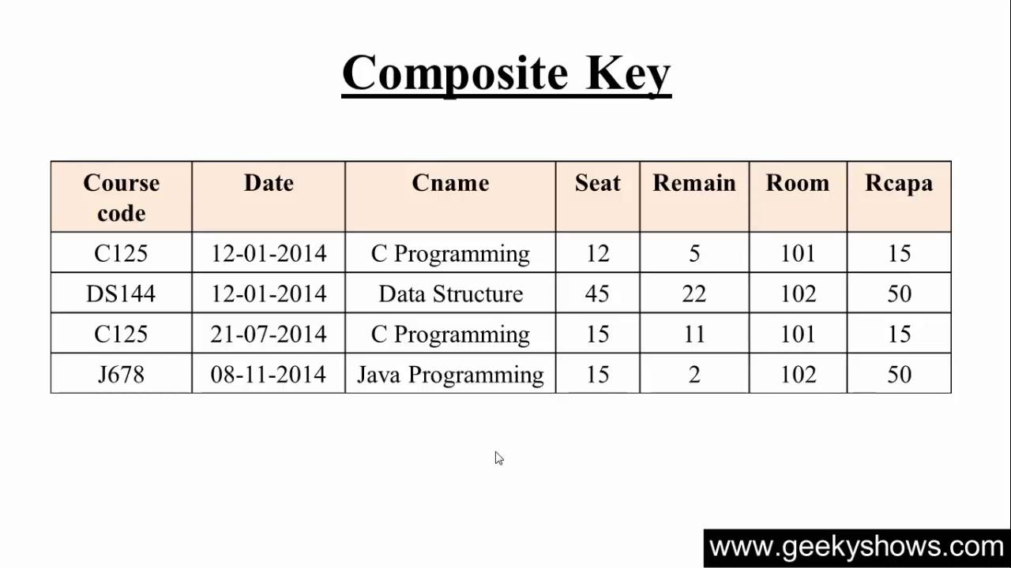

Composite Identifier: CourseCode , Date

Slide 22
Characteristic of Identifier
Will not change in value
Will not be null
No intelligent identifiers whose structure indicates classification, locations, or people that might change
Substitute new, simple keys for long, composite keys

Slide 23
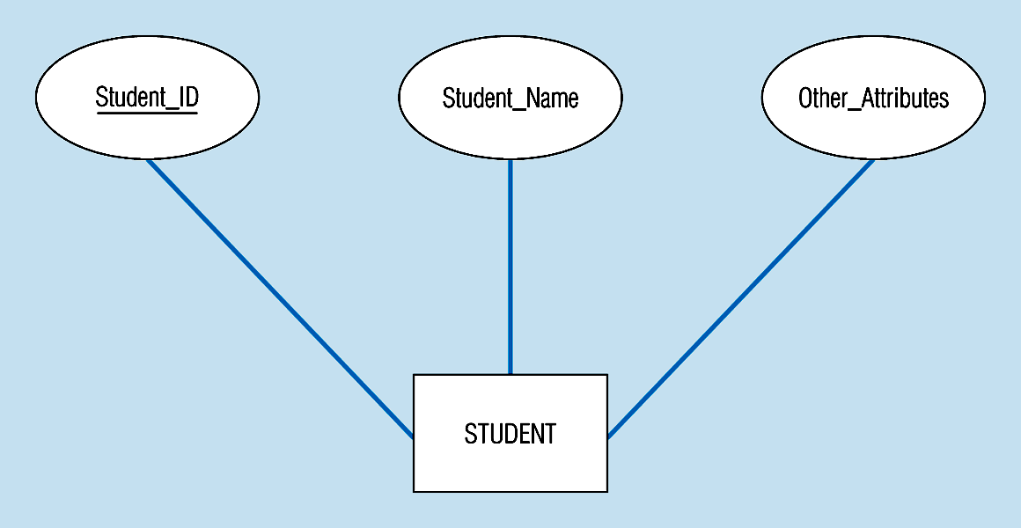
Simple Key Attribute
The key is underlined

Slide 24
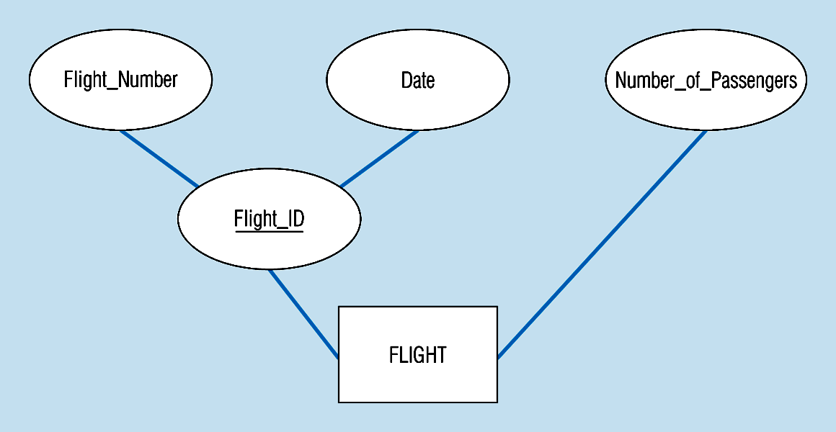
Composite Key Attribute
The key is composed
of two subparts

Slide 25
Relationship
Author
Associations between instances of one or more entity types that is of interest
Given a name that describes its function.
relationship name is an active or a passive verb.
writes
An author writes one or more books. A book can be written by one or more authors.
Book

Slide 26
Relationship
Relationship Types vs. Relationship Instances
The relationship type is modeled as the diamond and lines between entity types, whereas the relationship instance is between specific entity instances
Relationships can have attributes.
These describe features pertaining to the association between the entities in the relationship.
Two entities can have more than one type of relationship between them (multiple relationships)
Associative Entity = combination of relationship and entity

Slide 27
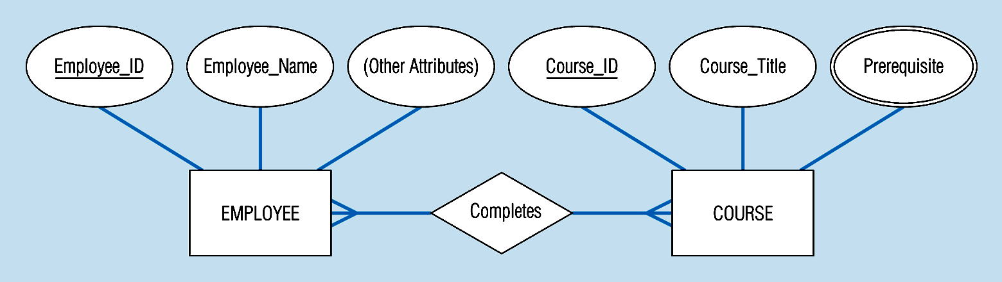
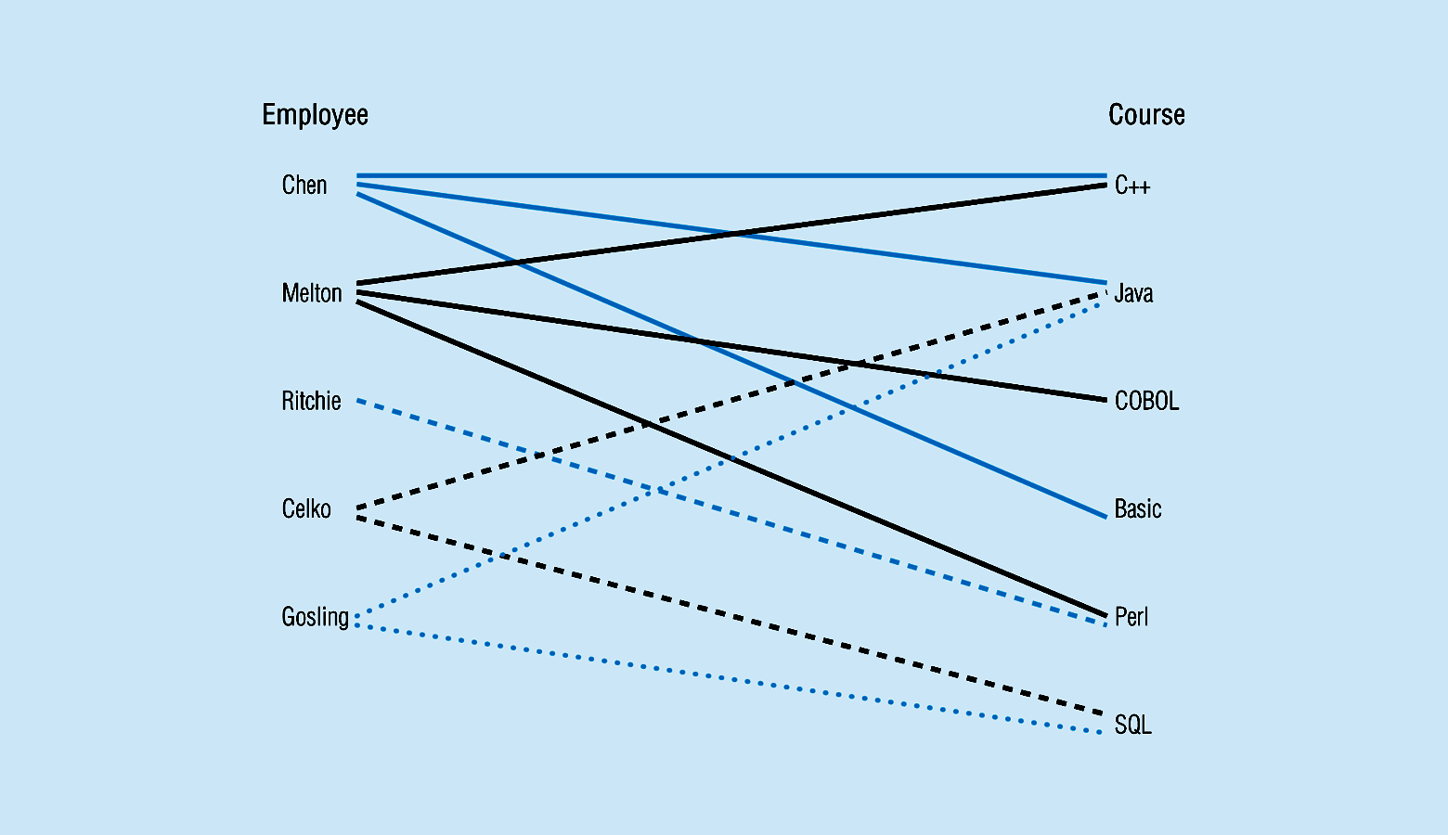
Relationship type
Entity and Relationship instances

Slide 28
Degree of Relationship
The degree of a relationship is the number of entity types that participate in it
Unary Relationship
Binary Relationship
Ternary Relationship

Slide 29
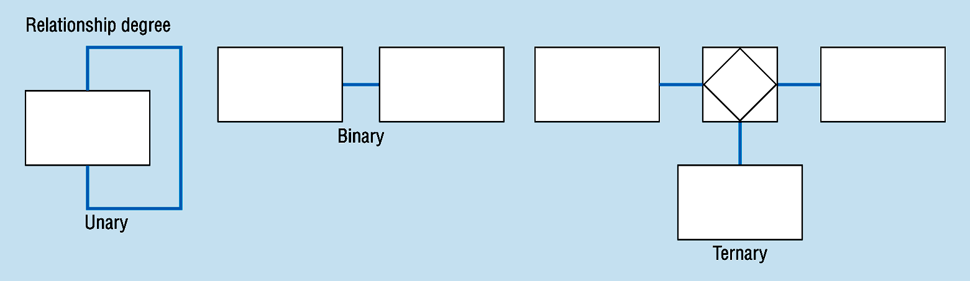
Entities of two different types related to each other
One entity related to another of the same entity type
Entities of three different types related to each other

Slide 30
Cardinality of Relationship
One–to–One
Each entity in the relationship will have exactly one related entity instance.
One–to–Many
An entity on one side of the relationship can have many related entity instances, but an entity on the other side will have a maximum of one related entity-instance
Many–to–Many
Entities on both sides of the relationship can have many related entity instances on the other side.

Slide 31
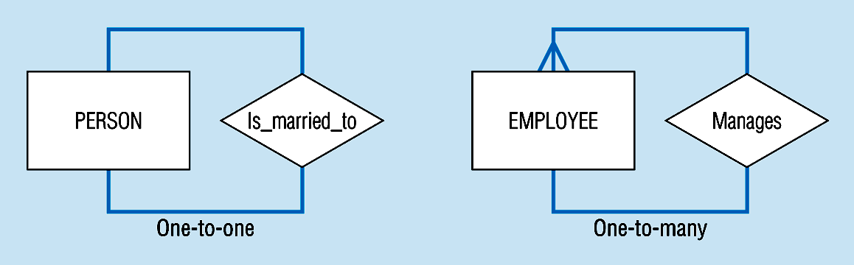
Degree of relationships and Cardinality
(a) Unary relationships

Slide 32
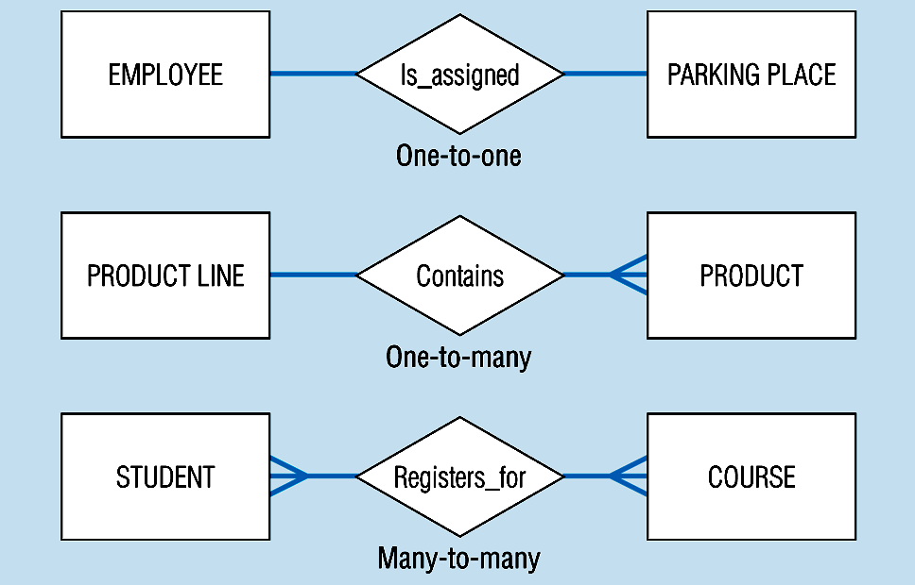
(b) Binary relationships

Slide 33
(c) Ternary relationships (1)
STUDENT
COURSE
registers
LECTURER
A simultaneous relationship between instances of three entity types.
The above E-R diagram shows that:
A student can register for many courses, and a course can be registered by many students.
A student can have many lectures, and a lecture can have many students.
A lecturer can teach many courses, and a course can be taught by many lecturers.

Slide 34
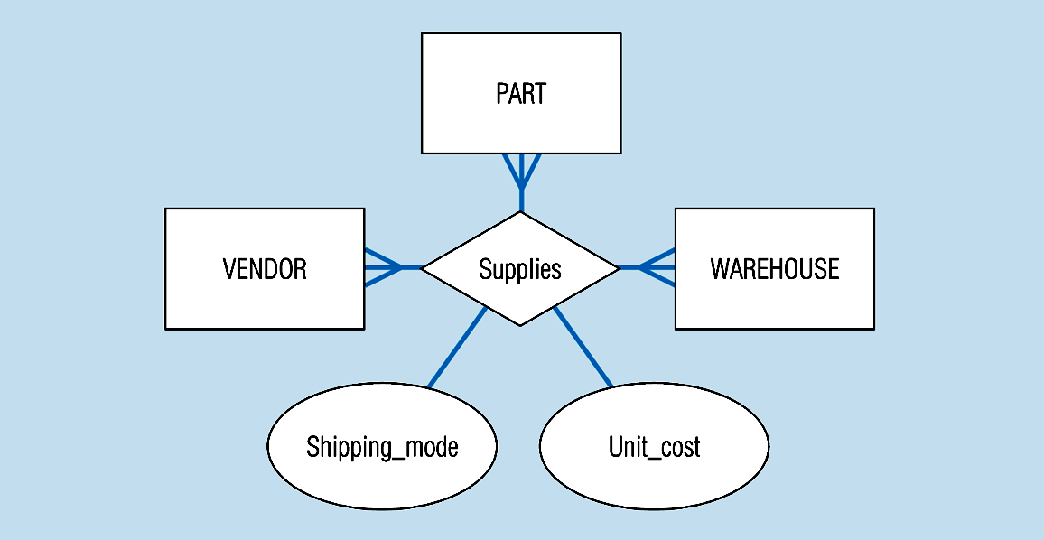
(c) Ternary relationships (2)
Note: a relationship can have attributes of its own

Slide 35
Cardinality Constraint
Cardinality Constraints - the number of instances of one entity that can or must be associated with each instance of another entity.
Minimum Cardinality
If zero, then optional
If one or more, then mandatory
Maximum Cardinality
The maximum number

Slide 36
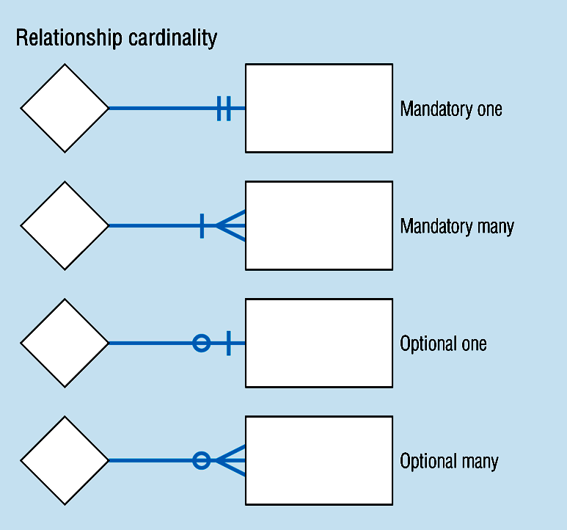
Cardinality Mandatory and Optional

Slide 37
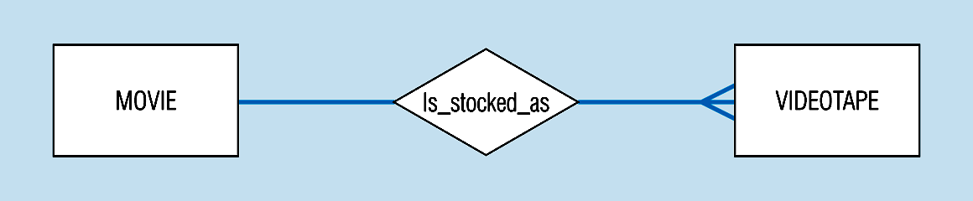
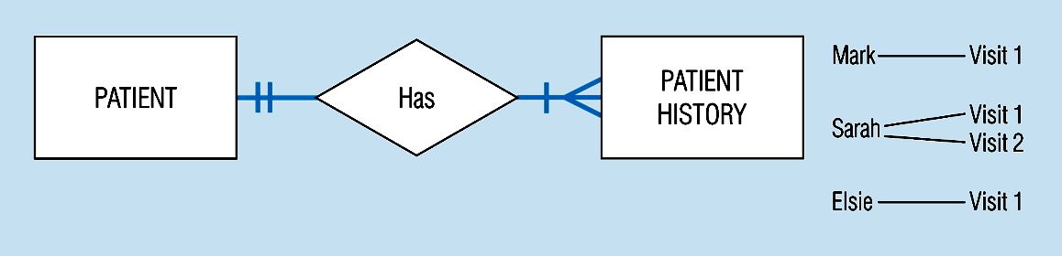
Cardinality Constraint
(a) Basic relationship with only maximum cardinalities showing
(b) Mandatory minimum cardinalities

Slide 38
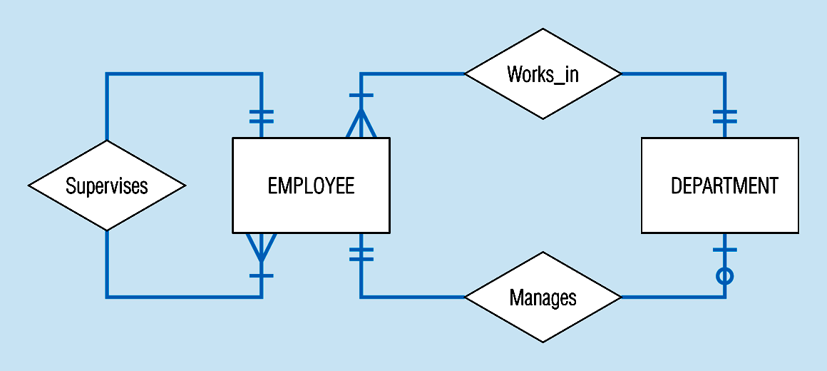
Example of multiple relationships
Employees and departments – entities can be related to one another in more than one way

Slide 39
Associative Entity
It’s an entity – it has attributes.
Also, it’s a relationship – it links entities together.
When should a relationship with attributes instead be an associative entity?
All relationships for the associative entity should be many
The associative entity could have meaning independent of the other entities
The associative entity preferably has a unique identifier and should also have other attributes
The associative may be participating in other relationships other than the entities of the associated relationship
Ternary relationships should be converted to associative entities

Slide 40
Certificate_Number
Date_Completed

Slide 41
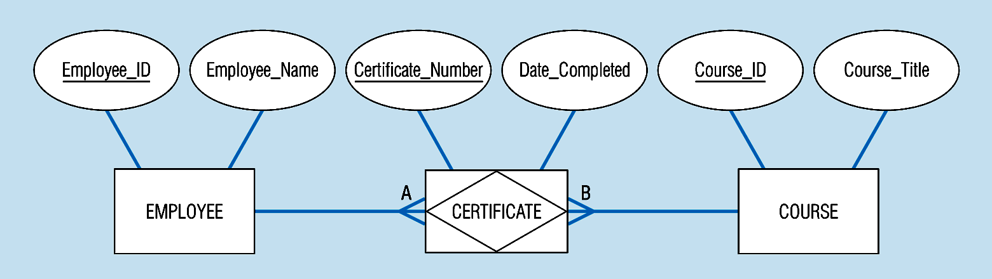
An Example of Associative Entity - CERTIFICATE
An associative entity involves a rectangle with a diamond inside.
Note that the many-to-many cardinality symbols face toward the associative entity and not toward the other entities.

Slide 42
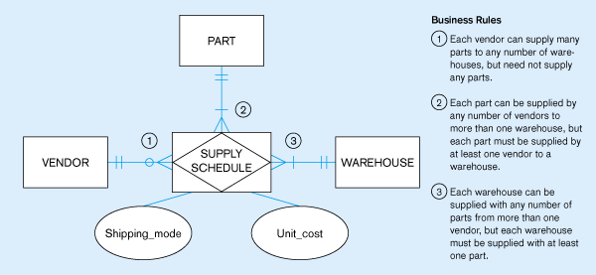
(b)Ternary relationship as an associative entity

Slide 43
ERD Practice (1)
For each pair of sentences, identify entities and the relationship representing the sentences.
"Each student must take one or more modules." "Each module must be taken by one or more student(s)."
"Each customer must receive at least one delivery.” “Each delivery must be only for one customer.”
“A client may have an account manager.” “Each account manager has only one client."

Slide 44
ERD Practice (2)
An automobile insurance company needs to keep track of information about vehicle policyholders. The company has to store information about customers, cars, and accidents. Customer information is License_no, name, and address. Customers can own one or more cars, where the car information is Plate_no, model, and year. A car may be involved in many accidents or none. If the car is involved in an accident, the information stored is Report_number, location, and date. For each car that is involved in the accident, the damage amount will be estimated.
Draw the ERD.

Slide 45
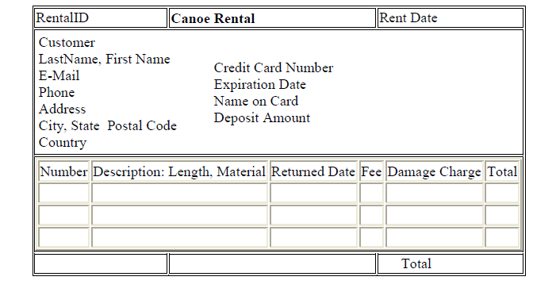
ERD Practice (3)
A small company that rents canoes need a database to track basic information about the rental and the canoes. Eventually, the firm wants to identify customers who cause problems by damaging the canoes, but for now, the managers just want to track the costs. The managers have outlined the data as a form.
Draw an ER diagram for this case.

Slide 46

End of Chapter

